Slide 1
Fantasy Premier League
By:
Abdelrahman Ahmed Mohamed 36
Ahmed Nasser 9

Slide 2
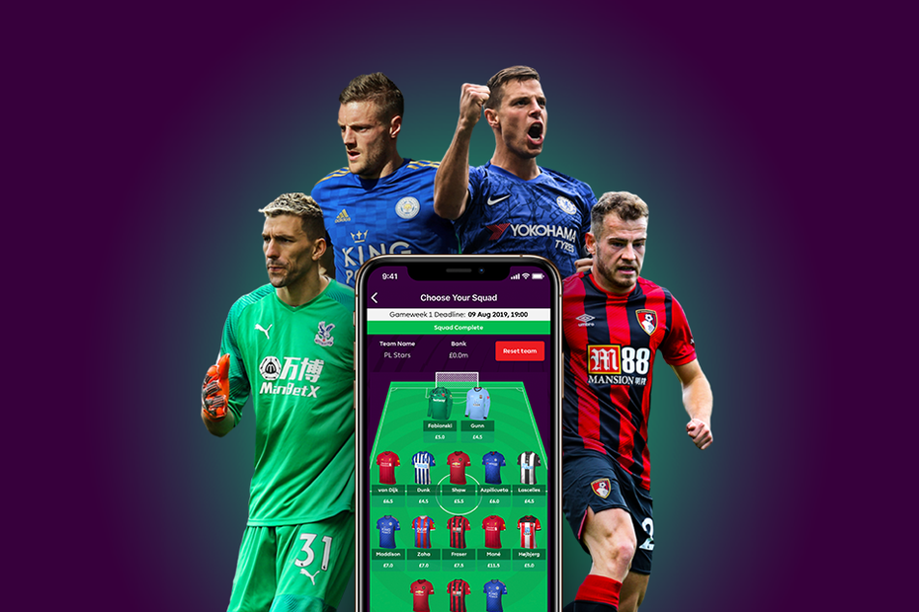
Fantasy ?!

Slide 3
Fantasy ?!

Slide 4
Fantasy ?!
Over 6 million players
Rules

Slide 5
Fantasy ?!
Over 6 million players
Rules
How to win ?

Slide 6
Fantasy ?!
Over 6 million players
challenges
Rules
How to win ?

Slide 7
Fantasy ?!
Over 6 million players
challenges
Rules
Why ?
How to win ?

Slide 8
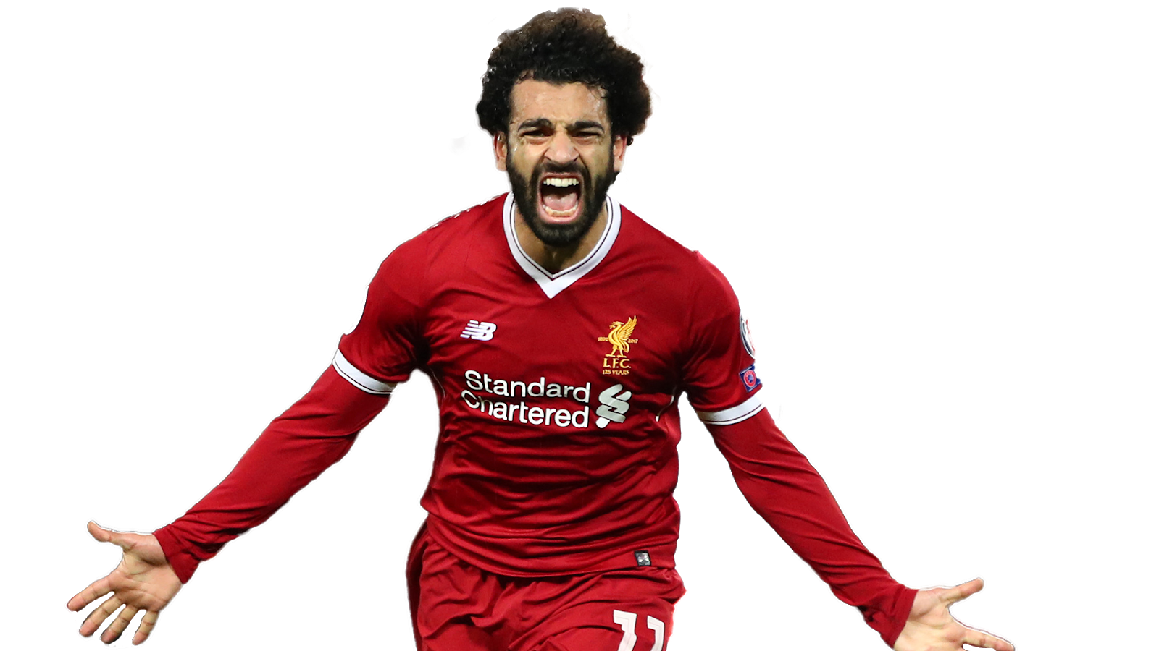
Related Work and Differences
Example [1]
Differences
Players vs Users
[1]

Slide 9
Data set
Data different
Representations

Slide 10
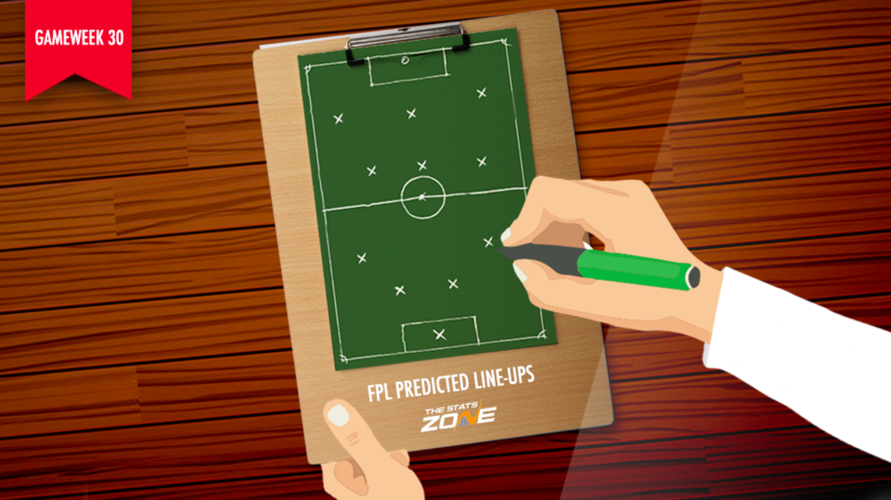
Train on users decision
Data set
Data different
Representations

Slide 11
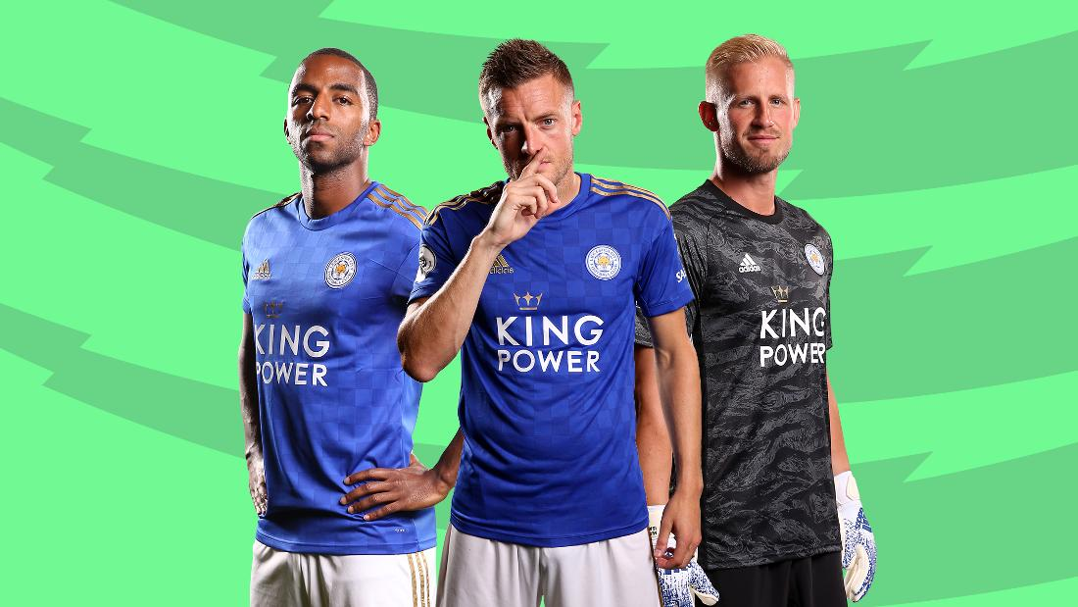
Train on users decision
Data set
Data different
Representations
Train on the players themselves

Slide 12
Train on users decision
Data set
Data different
Representations
Which representation ?
Train on the players themselves

Slide 13
Data set
Data different
Representations
Which representation ?

Slide 14
Features
G1 ( Previous gameweek statistics )
G2 ( Current gamewek features )
G3 ( general calculation on the whole data )
G4 ( future features like the difficulty of upcoming matches )

Slide 15
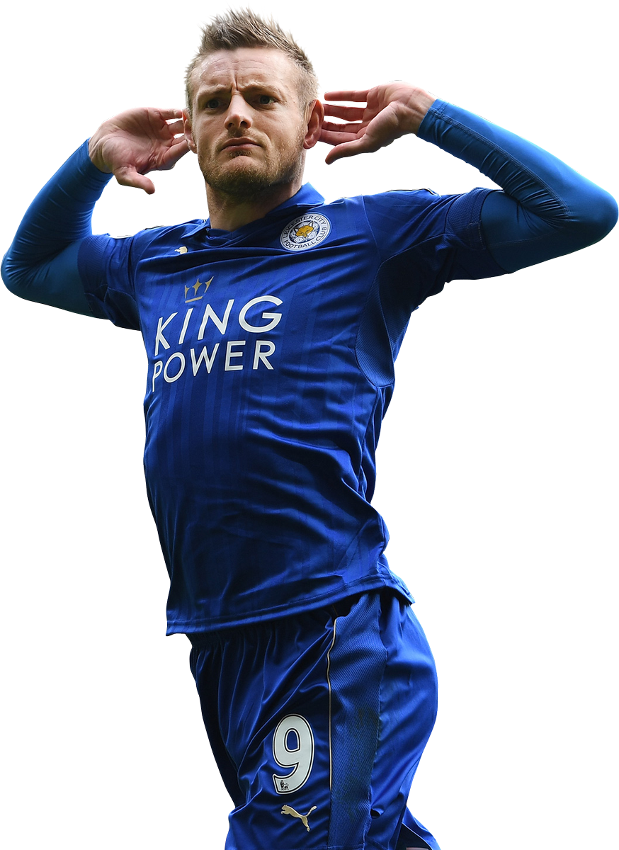
Example :
Features
assists 0
attempted_passes 12
big_chances_missed 0
bonus 3
bps 31
completed_passes 11
creativity 26.7
dribbles 1
element 234
fixture 349
goals_conceded 2
goals_scored 1
ict_index 11.1
influence 41.4
Key_passes 2
minutes 90
offside 2
opponent_team 19
selected 597135
target_missed 1
team_a_score 2
team_h_score 2
threat 43.0
total_points 9
transfers_balance -279714
transfers_in 12656
transfers_out 292370
value 90
was_home False

Slide 16
G1
Example :
Features
assists 0
attempted_passes 12
big_chances_missed 0
bonus 3
bps 31
completed_passes 11
creativity 26.7
dribbles 1
element 234
fixture 349
goals_conceded 2
goals_scored 1
ict_index 11.1
influence 41.4
Key_passes 2
minutes 90
offside 2
opponent_team 19
selected 597135
target_missed 1
team_a_score 2
team_h_score 2
threat 43.0
total_points 9
transfers_balance -279714
transfers_in 12656
transfers_out 292370
value 90
was_home False

Slide 17
G2[of the next gameweek]
Example :
Features
assists 0
attempted_passes 12
big_chances_missed 0
bonus 3
bps 31
completed_passes 11
creativity 26.7
dribbles 1
element 234
fixture 349
goals_conceded 2
goals_scored 1
ict_index 11.1
influence 41.4
Key_passes 2
minutes 90
offside 2
opponent_team 19
selected 597135
target_missed 1
team_a_score 2
team_h_score 2
threat 43.0
total_points 9
transfers_balance -279714
transfers_in 12656
transfers_out 292370
value 90
was_home False

Slide 18
G3
Example :
Features
assists 0
attempted_passes 12
big_chances_missed 0
bonus 3
bps 31
completed_passes 11
creativity 26.7
dribbles 1
element 234
fixture 349
goals_conceded 2
goals_scored 1
ict_index 11.1
influence 41.4
Key_passes 2
minutes 90
offside 2
opponent_team 19
selected 597135
target_missed 1
team_a_score 2
team_h_score 2
threat 43.0
total_points 9
transfers_balance -279714
transfers_in 12656
transfers_out 292370
value 90
was_home False

Slide 19
G4
Example :
Features
assists 0
attempted_passes 12
big_chances_missed 0
bonus 3
bps 31
completed_passes 11
creativity 26.7
dribbles 1
element 234
fixture 349
goals_conceded 2
goals_scored 1
ict_index 11.1
influence 41.4
Key_passes 2
minutes 90
offside 2
opponent_team 19
selected 597135
target_missed 1
team_a_score 2
team_h_score 2
threat 43.0
total_points 9
transfers_balance -279714
transfers_in 12656
transfers_out 292370
value 90
was_home False

Slide 20
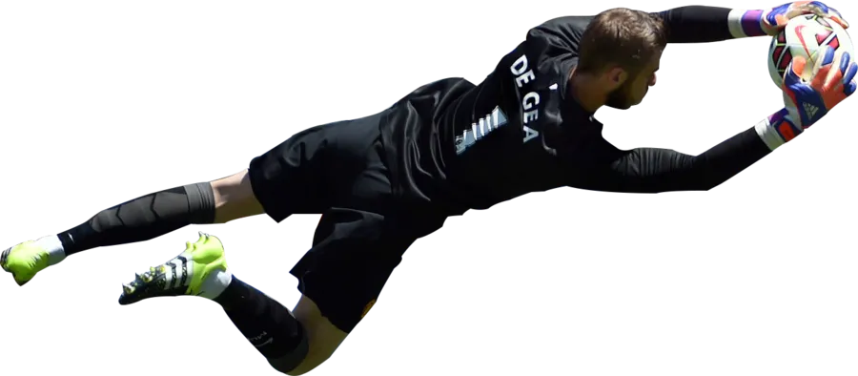
Evaluation
Total points ( problem? )
Upcoming gameweek
Consistency

Slide 21
Evaluation
Total points ( problem? )
Upcoming gameweek
Consistency
Value of the player
Salah costs 13(out of 100)$ !!

Slide 22
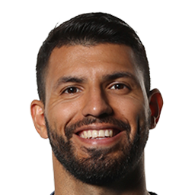
Evaluation
Total points ( problem? )
Upcoming gameweek
Consistency
Value of the player
Salah costs 13(out of 100)$ !!
Differentiality
Selected by how many?
Aguero is always selected by more than 50%

Slide 23
Model
Dynamic fully connected model architecture based on selected parameters
Number of hidden layers
Number of units in each layer
Activation function for output ?!
Yes, Linear
Used Loss
Absolute? / Square ?

Slide 24
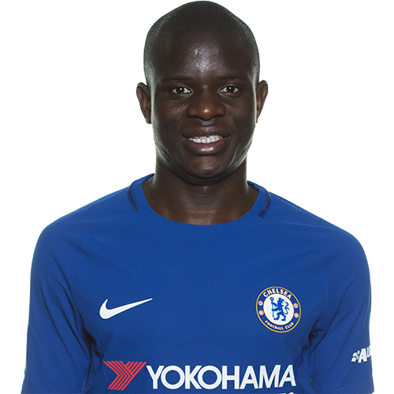
Current progress & Initial results
What we have done so far :
Feature extraction
Preprocessing
Evaluation function
Initial model

Slide 25
Current progress & Initial results
For an initial fully connected neural network of 3 hidden layers of ( 24, 36, 64 ) units --
Different learning rate
0.0001,0.00001

Slide 26
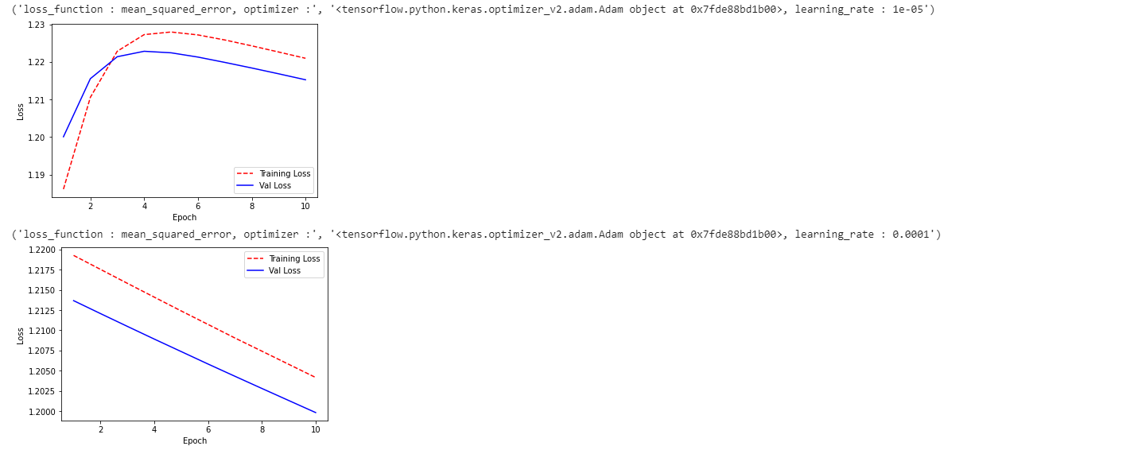
Current progress & Initial results
For an initial fully connected neural network of 3 hidden layers of ( 24, 36, 64 ) units
Different activation functions
Different loss functions

Slide 27
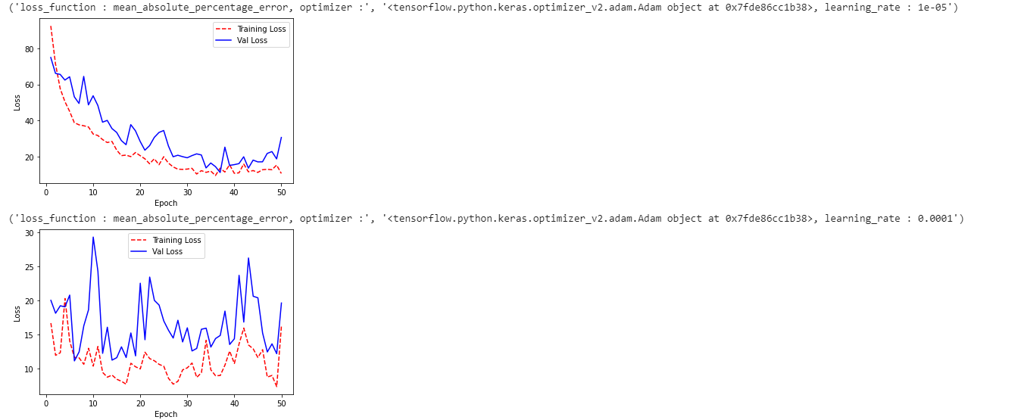
Current progress & Initial results
For the initial fully connected neural network of 3 hidden layers of ( 24, 36, 64 ) units
Different activation functions
Different loss functions
Different number of epochs
50 Epochs

Slide 28
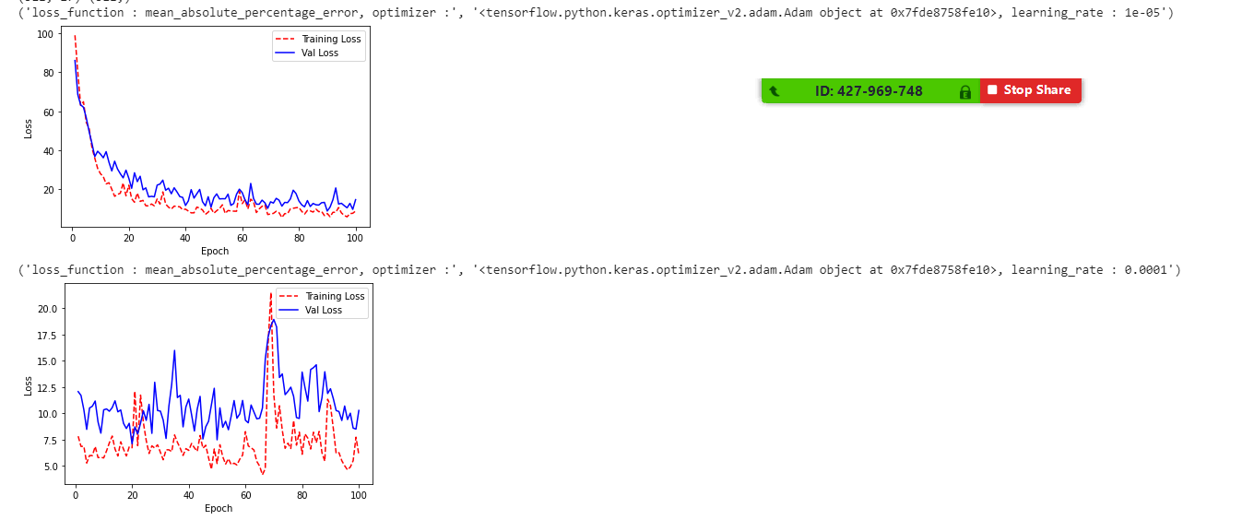
Current progress & Initial results
For the initial fully connected neural network of 3 hidden layers of ( 24, 36, 64 ) units
Different activation functions
Different loss functions
Different number of epochs
100 Epochs

Slide 29
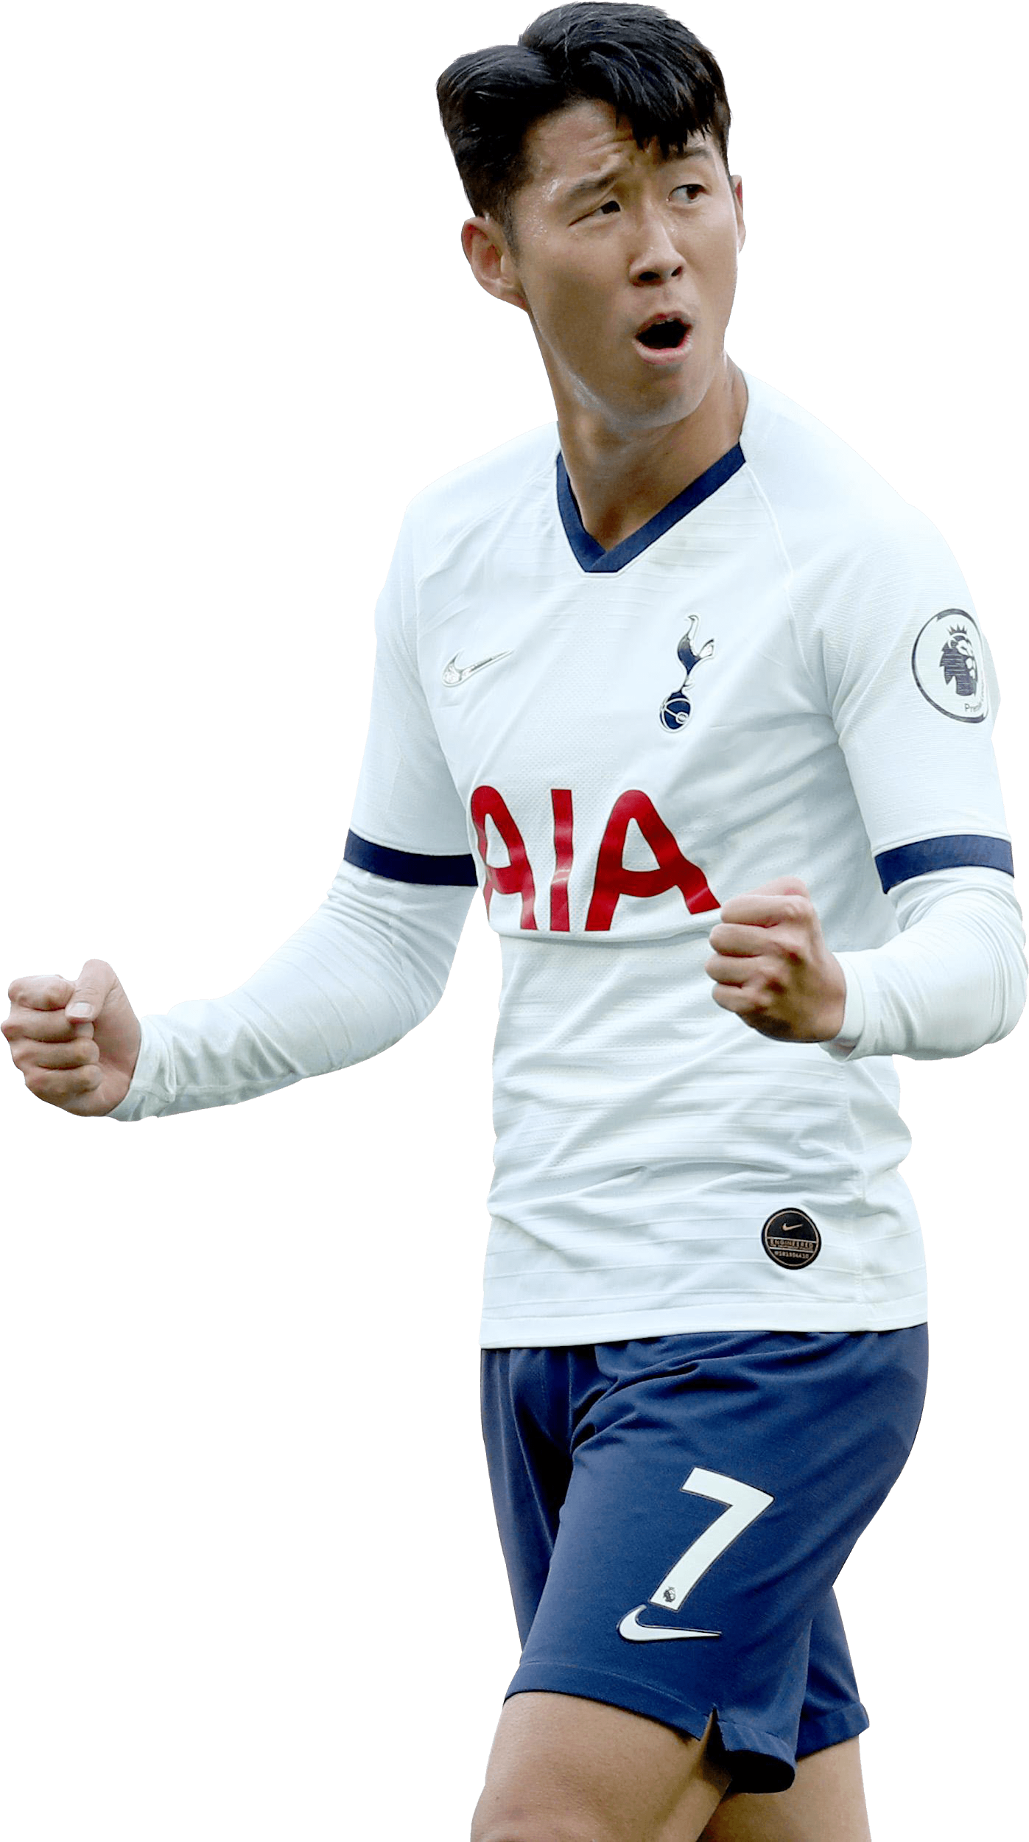
Next Steps :
Adding Groups 2 and 3 to the features
Training on more data
Adding more factors to the score function
Implementing the evaluation function (to compare the model output to the best players in each gameweek for different value ranges)
Parameter tuning
Testing on 2019-20 season

Slide 30
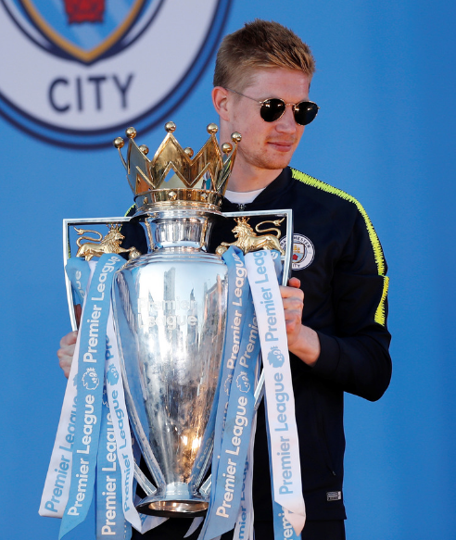
Thanks :D
Questions ?

